Slide 1
SGLT-2 hämmare
Dorota de Laval 220427

Slide 2
SGLT-2 hämmare
Sodium/GLucos-coTransporter-2 –inhibitorer
(njurtubuli)
Dapagliflozin (Forxiga) Xigduo, Qtern
Empagliflozin (Jardiance) Synjardy, Glyxambi
Kanagliflozin (Invocana) Vokanamet
Ertugliflozin (Steglatro) Segluromet, Steglujan

Slide 3
Renalt återupptag av glukos hos friska individer
Filtrerat glukos ca 180 g/dag
SGLT2
~90 %
SGLT1
~10 %
Gerich JE. Diabet Med 2010;27:136–42.
Notes:
In healthy subjects in the kidney, the amount of glucose reabsorbed through the SGLT1 and SGLT2 transporters is equal to the amount of glucose that is filtered by the glomerulus. Glucose reabsorption by the proximal tubule increases linearly with increasing glucose concentration, up to a theoretical threshold of approximately 180 mg/dl . The SGLT2 transporter mediates 90% of renal glucose reabsorption by coupling glucose transport to the electrochemical sodium gradient. The other 10% of renal glucose reabsorption occurs through SGLT1, a high-affinity, low-capacity transport protein that is found in the more distal, straight section of the proximal tubule (S3), where there is less luminal glucose. Recent study suggest that in status with low blood glucose SGLT1 is responsible for a higher percentage of renal reabsorption.

Slide 4
Renalt återupptag av glukos hos patienter med hyperglykemi
Filtrerat glukos ca 180 g/dag
SGLT2
~90 %
Över ett tröskelvärde (~10 mmol/l), mättas transport-kapaciteten och glukos utsöndras i urinen
SGLT1
~10 %
Gerich JE. Diabet Med 2010;27:136–42.
Notes:
At a certain glucose concentration the glucose flux is to high and the glucose transport system becomes saturated . All the filtered glucose in excess of this threshold is excreted In the urine.
DeFronZo EASD 2012 abstract:
Dapagliflozin reduces renal threshold for glucose excretion in T2D
R.A. DeFronzo1, M. Hompesch2, S. Kasichayanula3, X. Liu3, Y. Hong3, M. Pfister3, L.A. Morrow2,
B.R. Leslie3, D.W. Boulton4, A. Ching3, F.P. LaCreta3, S.C. Griffen3;
1
University of Texas Health Science Center, San Antonio, 2Profil Institute for Clinical Research,
Chula Vista, 3Bristol-Myers Squibb, Princeton, 4Bristol-Myer Squibb, Princeton, USA.
Background and aims: Dapagliflozin is a selective sodium-glucose co-transporter 2 (SGLT2)
inhibitor that reduces hyperglycaemia in T2D by promoting urinary glucose excretion. This
study examined the effect of dapagliflozin on renal glucose kinetics in healthy subjects and subjects
with T2D.
Materials and methods: Renal glucose kinetics were assessed in 12 healthy control subjects (HbA1c
5.5 %, 41 years, 27 kg/m2, 7 male/5 female) and 12 subjects with T2D (HbA1c 6.5%, 53
years, 30 kg/m2, 7 male/5 female). All subjects had an estimated glomerular filtration rate (eGFR) ≥
60 and ≤ 160 mL/min∙1.73 m2 by the Modification of Diet in Renal Disease equation. Subjects
underwent a combined pancreatic and stepped hyperglycaemic clamp at baseline and after 7 days of
dapagliflozin 10 mg/day. The pancreatic/stepped hyperglycaemic clamp was performed with
octreotide and basal insulin/glucagon/growth hormone replacement, and evaluated a plasma glucose
range of 100-550 mg/dL. Subjects with T2D continued on baseline therapy unless taking
metformin, which was held for 48 h before the pancreatic stepped hyperglycaemic clamp. A model
was developed to describe maximum tubular glucose transport (TmG), renal glucose threshold (for
onset of glucosuria), and splay of the glucose titration curve for healthy and T2D
populations, and then used to estimate these parameters from individual titration curves.
Results: At baseline, the TmG (443 vs 326 mg/min, P<0.04) and splay (28,650 vs 14,248 mg2/min2,
P<0.0001) were significantly higher in subjects with T2D vs controls. The baseline
threshold was similar in subjects with T2D (196 mg/dL [10.9 mmol/L]) and controls (171
mg/dL [9.5 mmol/L]). Dapagliflozin treatment reduced TmG by 58% in T2D subjects and
53% in healthy subjects. The splay declined similarly by ~37% for both groups. Following
dapagliflozin, the modelled threshold was markedly reduced in T2D patients, by 89% (21
mg/dL [1.2 mmol/L]) and in healthy controls, by 78% (37 mg/dL [2.1 mmol/L]). These modelled
threshold values were well below the plasma glucose levels measured in this study. A modest
reduction in GFR (~14%) was observed following dapagliflozin treatment in both groups.
Conclusion: In summary, T2D subjects have a higher TmG and splay than healthy
controls. Dapagliflozin treatment for 7 days reduced TmG and splay. However, the markedly
decreased renal glucose threshold was the primary mechanism responsible for the induction of
glucosuria with dapagliflozin in both subjects with T2D and healthy controls.
Clinical Trial Registration Number: NCT01165268
Supported by: AstraZeneca and Bristol-Myers Squibb

Slide 5
Utsöndring av glukos i urinen via SGLT2-hämning
Filtrerat glukos ca 180 g/dag
SGLT2- hämmare
SGLT2
Återupptaget av glukos minskar och leder till glukosutsöndring och osmotisk diures
SGLT1
*Loss of ~80 g of glucose/day (~240 cal/day).
Gerich JE. Diabet Med 2010;27:136–42.
Notes:
SGLT2 inhibition lowers the Tm – the maximum reabsorptive capacity of the proximal tubule and lower the renal threshold for Glucose. Therefore, treated subjects will start to renally excrete glucose. The amount of excreted glucose is dependent on the Glucose filtration and therefore dependent on the blood glucose values. In the hypoglycaemic Range the amount of Glucose which is excreted will be very small and with rising blood Glucose the excreted glucose will also increase. Subjects with high baseline glucose will have a much higher glucose excretion rate than subjects which are near normal. In the PK/PD studies a UGE (urinary glucose excretion) of around 80 grams per day was measured. The Glucose loss is associated with fluid loss (increase in urine volume), osmotic diuresis and of with caloric loss. (average of 240 cal/per day)

Slide 6
Renalt återupptag och utsöndring av glukos
Glukosreabsorption är ökad vid T2DM...
Glukos- filtrering
Glukos- utsöndring
...vilket minskar mängden glukos som utsöndras vid en given plasmaglukosnivå
T_{max}
Glukos- reabsorption
SGLT2-hämmare minskar mängden glukos som kan reabsorberas
Glukosflöde
Glukos- reabsorption vid SGLT2- hämning
Det ökar utsöndringen av glukos
0
5
10
15
20
25
30
Plasmaglukos (mmol/l)
Nair S, Wilding JPH. J Clin Endocrinol Metab 2010;95:34–42.
Notes:
As the level of glucose in the blood rises, the amount of Glucose which is filtered in the kidney increase (yellow). The reabsorption rate progressively increases up to the point marked Tmax (red line). At plasma glucose concentrations below this level, all the filtered glucose is reabsorbed (observe that the ‘filtered’ and ‘reabsorbed’ curves are superimposed below this point. As the filtered and reabsorption curves separate, the point marked ‘threshold’ is reached, and the body starts to excrete glucose into the urine (green line) (i.e. as the plasma glucose concentration rises, there comes a point where the maximum reabsorptive capacity of the proximal tubule is exceeded). Above this point, the ‘excreted’ curve rises with increasing plasma glucose concentration. In T2D the Tmax is slightly increased due to up regulation of SGLT2, therefore the renal Glucose excretion is shifted to the right (green line). Inhibition of SGLT2 changes the titration curve of renal glucose absorption. SGLT2 inhibition lowers the Tm – the maximum reabsorptive capacity of the proximal tubule – and such an individual will start to renally excrete up to 80 g glucose per day (see graph). As the Tm is lowered, the excreted curve is left shifted and also the threshold where Glucose will occur in the urine is shifted to a hypoglycaemic range.

Slide 7
Effekt på glukos
Minskar HbA1c med 7-10 mmol/mol
Effekten är oberoende av behandling med andra antidiabetika
Verkningsmekanism är glukosberoende
Glukossänkande effekten är beroende av den glomerulära filtrationen - sjunker vid eGFR<60 och nästan helt uteblir vid eGFR<30 ml/min/1,73 m
Effekten hos individer med dålig glykemisk kontroll (HbA1c>64) är likartad för olika doser

Slide 8
EMPA-REG 2015

Slide 9
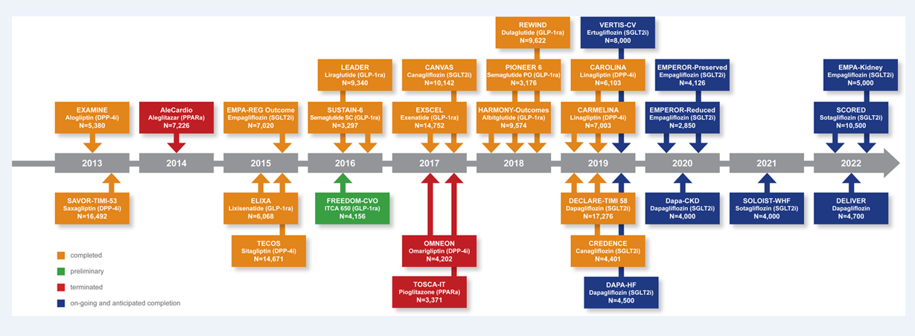

Slide 10
Föreslagna verkningsmekanismer för njur- och kardioprotektion
SGLT2i
Glycosuria
Natriuresis
Negative caloric balance
↓ HbA1C
↑ Uricosuria
↓ Blood pressure
↓ Plasma volume
↑ Tubulo-glomerular
feedback
↓ Total body fat mass
↓ Inflammation
↓ Glucose toxicity
↓ Plasma uric acid
↓ Arterial stiffness
↓ Myocardial stretch
Afferent arteriole constriction
↓ Epicardial fat
↓ Atherosclerosis
↓ Ventricular arrhythmias
Activation of ACE2 – Ang1/7
↓ Inflammation
↓ Fibrosis
↑ Cardiac contractility
↓ Intraglomerular hypertension
↓ Hyperfiltration
Cardiac and renal protection
Heldragna linjer representerar mekanismer bekräftade av data. Streckade linjer representerar mekanismer som behöver studeras. ACE2, angiotensinkonverterande enzym-2; Ang 1/7, angiotensin 1/7
Rajasekeran H et al. Kidney Int 2016;89:522

Slide 11
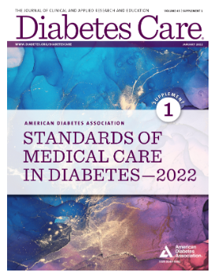

Slide 12
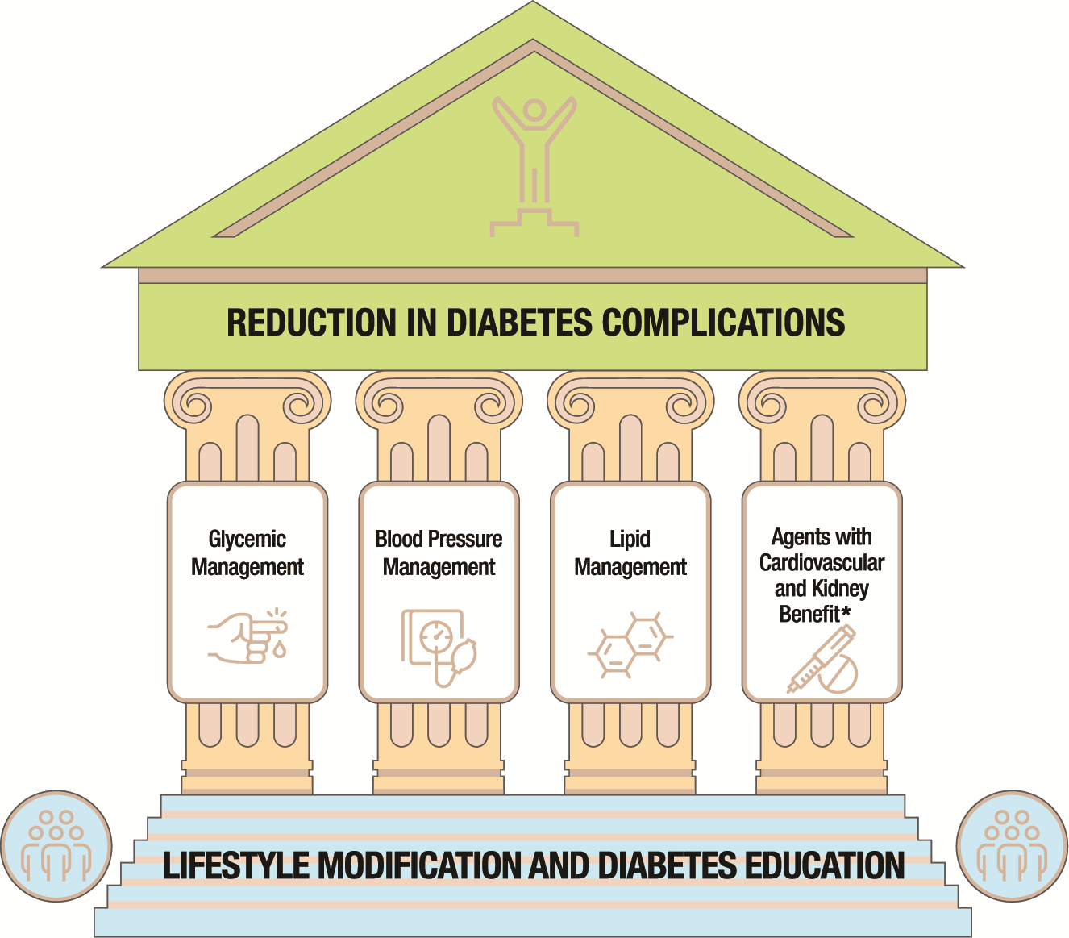
From: 10. Cardiovascular Disease and Risk Management: Standards of Medical Care in Diabetes—2022
Diabetes Care. 2021;45(Supplement_1):S144-S174. doi:10.2337/dc22-S010
Figure Legend:
Multifactorial approach to reduction in risk of diabetes complications. *Risk reduction interventions to be applied as individually appropriate.
Date of Download: 4/11/2022
Copyright © 2022 American Diabetes Association. All rights reserved.

Slide 13
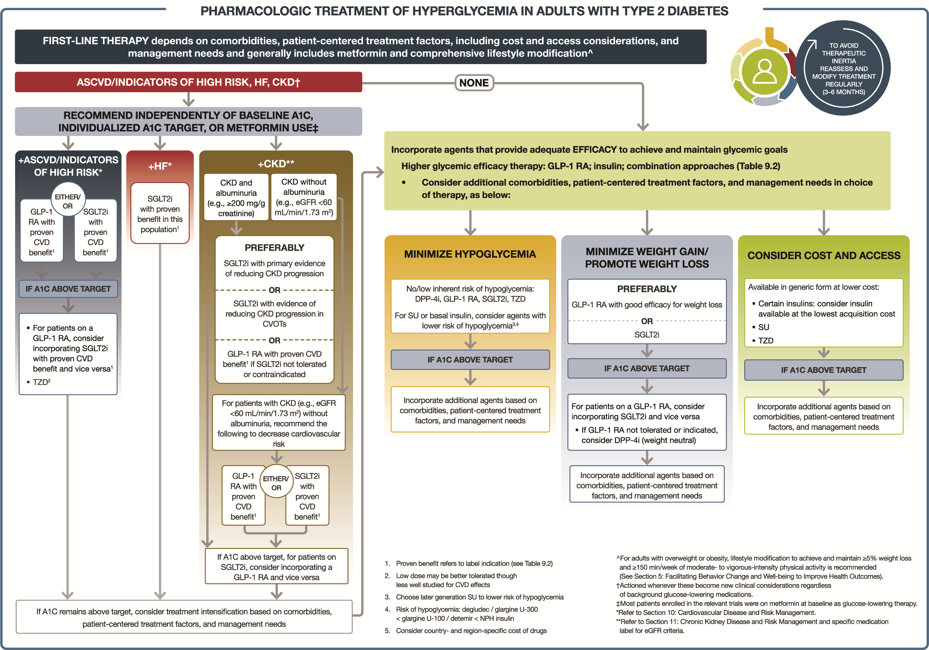

Slide 14
Riskfaktorer
Män >55 år ; kvinnor > 60 år + minst 1 av följande
1. hypertoni
2. LDL >3,4 mmol/L eller lipidsänkande behandling
3. rökning
At least 50 years old with at least 2 of the following CV risk factors - hypertension, diabetes duration of at least 10 years old, current smoking, micro- or macroalbuminuria or a low HDL level (<1mmol/L)

Slide 15
NDR riskberäkning

Slide 16
ASCVD Risk Estimator Plus

Slide 17
Nationella riktlinjer för diabetesvård

Slide 18
ESC guidelines 2021

Slide 19
Risk för ASCVD för diabetiker
Måttlig risk – välkontrollerad diabetes, sjukdomensduration<10 år, inga alvarliga organkomplikationer, inga andra riskfaktorer för ASCVD
Mycket hög risk – alvarliga organkomplikationer :
1. eGFR <45 ml/min/1,73m2
2. eGFR 45-59 ml/min/1,73m2 och mikroalbuminuri (30-300 mg/g)
3. makroalbminuri (>300 mg/g)
4. minst 3 olika mikrovaskulära komplikationer
(ex. retinopati+mikroalbuminuri+neuropati)

Slide 21
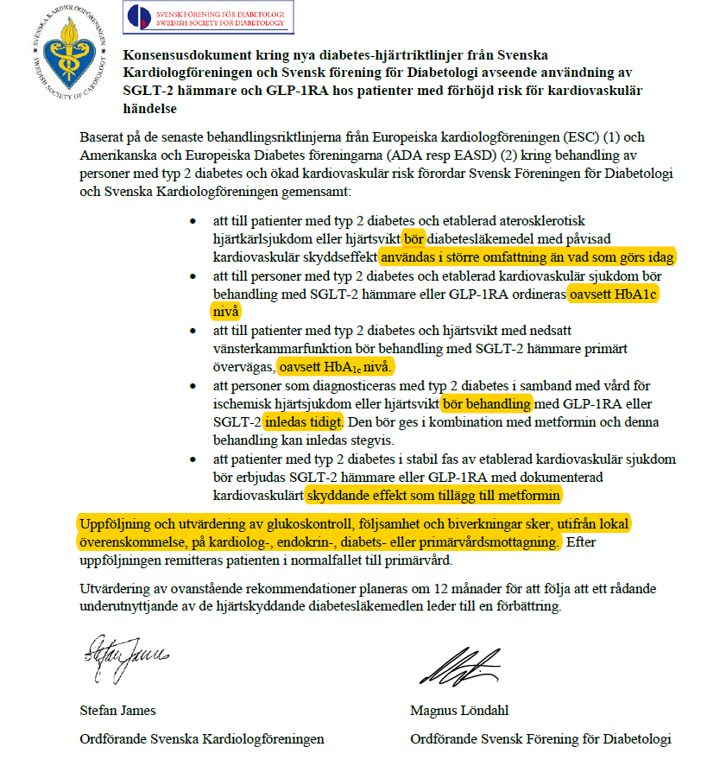

Slide 22
SGLT-2 hämmare
Ska inte användas
-vid insulinbrist
-vid risk för ketoacidos :
fasta, svalt, gastrointestinal sjk., lågkolhydrat kost
svår sjukdom eller kirurgi (relativ insulinbrist)
alkoholmissbruk
-patienter med bensår eller hög risk för amputation bör endast behandlas med SGLT2-hämmare efter en noga risknytta analys och en plan för fotvård och prevention

Slide 23
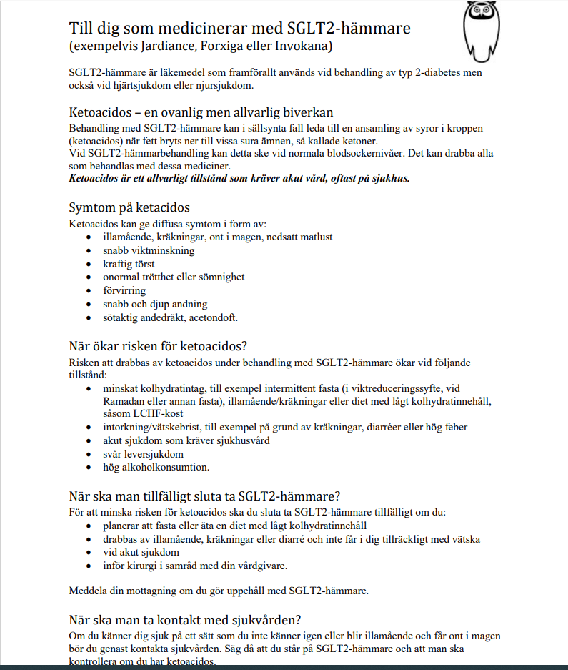

Slide 24
Ann 69 år
Föredetta rökare med KOL.
Patient har Typ 2-diabetes sedan 7år tillbaka. Behandlas med metformin och DPP4-hämmare. Har även hypertoni.
Inkommer till akuten med ST-höjningsinfarkt. Akut angiografi visar stopp på RCA som öppnas och stentas. Start av ASA 75 mg x1, tikagrelor 90 mg x 2 och atorvastatin 80 mg x1.
På återbesök hos kardiologen startas behandling med SGLT2-hämmare som kardiovaskulär protektion.
Patienten remitteras nu vidare till vårdcentralen för uppföljning.

Slide 25
Ann 69 år
Labb:
BMI: 28
HbA1c: 70 mmol/mol
Njurfunktion: eGFR 65 ml/min/1,73m², S-Krea 75 umol/L
Blodtryck: 145/90 mmHg
Kolesterol: Totalkolesterol 3,2 HDL 1,5 Triglycerider 0,9
LDL 1,3 mmol/L

Slide 26
Ann 69 år
Aktuell behandling:
ASA 75 mg x1
Tikagrelor 90 mg x 2
Atorvastatin 80 mg x1
Candesartan 32 mgx1
Metformin 500 mg x2
DPP4-hämmare x1
SGLT2-hämmare x1
Spiolto Respimat

Slide 27
Mål?
BMI ?
HbA1c ?
BT ?
LDL ?

Slide 28
Statinterapi – primär prevention – ADA/EASD
1. Pat 40-75 utan ASCVD måttligintensiv statinterapi + livstilsförändringar
2. Pat 20-39 med ASCVD-riskfaktorer kan statinterapi övervägas
3. Pat 50-70 med ASCDV-multipla riskfaktorer – högintensiv statinterapi
4. Pat med högrisk (>20%) för ASCVD – tillägg med Ezetimib till högdos statin (för att reducera LDL mer än 50%).

Slide 29
Statinterapi – sekundär prevention ADA/EASD
1. Alla diabetiker med ASCVD – högintensiv statinterapi
2. Om LDL> 1,8 mmol/L med högsta tolererade statindos– tillägg med Ezetimib eller PCSK9 inh. ska övervägas
3. För Pat som inte tolererar rek. statindos – det högsta tolererbara dosen ska användas
4. Pat äldre än 75 år, som redan har statinterapi – fortsätter
5. Pat äldre än 75 år med indikation för statinterapi kan påbörja terapi efter diskussion med Pat om risk/nytta
6. Statinterapi är kontraindicerad vid graviditet

Slide 30
Högintensiv statinterapi Reducerar LDL>50% | Måttligintensiv statinterapi Reducerar LDL 30-50%
Atorvastatin 40-80 mg | Atorvastatin 10-20 mg
Rosuvastatin 20-40 mg | Rosuvastatin 5-10 mg
 | Simvastatin 20-40 mg
 | Pravastatin 40-80 mg

Slide 31
Nationella riktlinjer för diabetesvård 2018

Slide 32
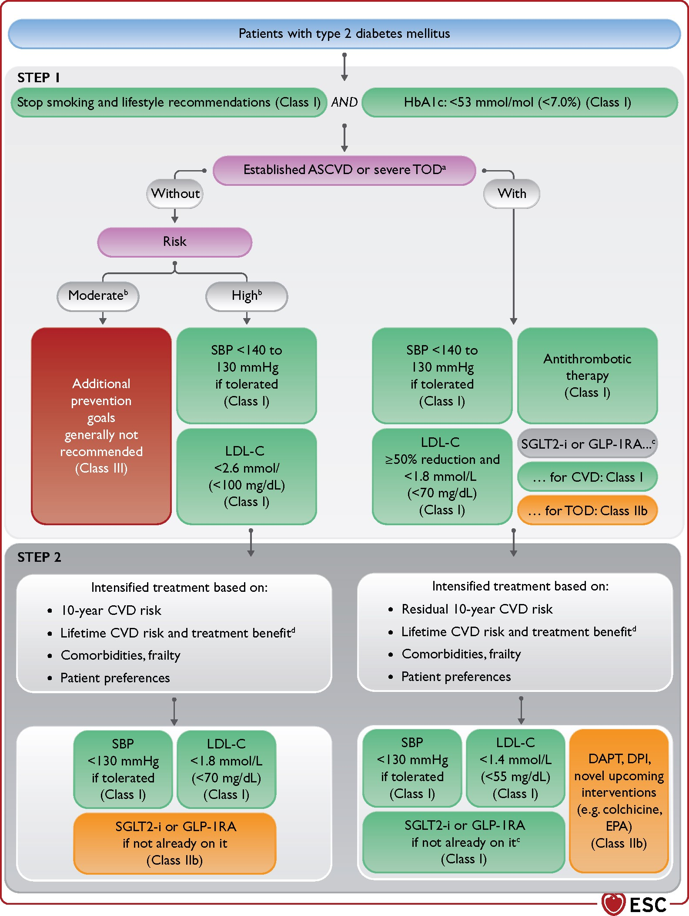
Figure 8 Flow chart of cardiovascular risk and risk factor treatment in patients with type 2 diabetes mellitus. ...
Notes:
Figure 8 Flow chart of cardiovascular risk and risk factor treatment in patients with type 2 diabetes mellitus. Ultimate treatment goals for SBP (<130 mmHg) and LDL-C (according to level of risk) according to the respective ESC Guidelines3,4 are to be pursued as indicated. The stepwise approach has to be applied as a whole: after STEP 1, considering proceeding to the intensified goals of STEP 2 is mandatory. Risk scores are available in the ESC CVD Risk Calculator app for mobile devices (https://www.escardio.org/Education/ESC-Prevention-of-CVD-Programme/Risk-assessment/esc-cvd-risk-calculation-app) and at websites such as https://www.u-prevent.com. ACR = albumin-to-creatinine ratio; ASCVD = atherosclerotic cardiovascular disease; CKD = chronic kidney disease; CVD = cardiovascular disease; DAPT = dual antiplatelet therapy; DM = diabetes mellitus; eGFR = estimated glomerular filtration rate; ESC = European Society of Cardiology; GLP-1RA = glucagon-like peptide-1 receptor agonist; HbA1c = glycated haemoglobin; HF = heart failure; LDL-C = low-density lipoprotein cholesterol; SBP = systolic blood pressure; SGLT2 = sodium-glucose cotransporter 2; TOD = target organ damage (retinopathy, nephropathy, neuropathy). aSevere TOD is defined as at least one of: eGFR <45 mL/min/1.73 m2 irrespective of the presence or absence of albuminuria; eGFR 46–59 mL/min/1.73 m2 and microalbuminuria (ACR 30–300 mg/g or 3–30 mg/mmol); proteinuria (ACR >300 mg/g or >30 mg/mmol); presence of microvascular disease in at least three different sites (e.g. microalbuminuria plus retinopathy plus neuropathy). bSee Table 4 for CVD risk groups. cPatients with prevalent HF or CKD are recommended for SGLT2 inhibitor, and patients post stroke are recommended for GLP-1RA treatment. dLifetime treatment benefit is expressed as extra CVD-free life gained from a certain intervention or treatment intensification. See Box 1.
Unless provided in the caption above, the following copyright applies to the content of this slide: This article has been co-published with permission in the European Heart Journal and the European Journal of Preventive Cardiology. © The European Society of Cardiology 2021. All rights reserved. The articles are identical except for minor stylistic and spelling differences in keeping with each journal’s style. Either citation can be used when citing this article. For ermissions, please email: journals.permissions@oup.com.This article is published and distributed under the terms of the Oxford University Press, Standard Journals Publication Model (https://academic.oup.com/journals/pages/open_access/funder_policies/chorus/standard_publication_model)

Slide 33
ESC (European Society of Cardiology) rekommenderar ( riktlinjer 2021 )
För Pat med diabetes t.2
1. och mycket hög risk (etablerad kardiovaskulär sjukdom eller alvarliga komplikationer) intensiv lipidsänkande behandling med LDL-mål <1,4 mmol/L
2. >40 årsålder och hög risk behandlingsmål <1,8 mmol/L
3. och t.1 och ålder<40 att överväga statinbehandling vid alvarliga komplikationer och/eller LDL>2,5 mmol/L så länge graviditet inte planeras
4. Om målet enl. ovan inte uppnås med statiner – tillägg med ezetimib.

